Slide 1


Year 3/4: Measure Capacity
© Classroom Secrets Limited 2018

Slide 2
Capacity and volume
Capacity is how much liquid a container can hold in total.
Volume is how much liquid is actually in the container.
We measure capacity and volume in litres and millilitres.
1000 millilitres (ml) = 1 litre (l)
Watch these videos
https://www.youtube.com/watch?v=GKCE8ohIBqE
https://www.youtube.com/watch?v=QMpkm4dAB4w
© Classroom Secrets Limited 2018

Slide 3
Example:
The capacity of this container (how much it can hold) is 250 millilitres (ml).
The volume of this container (how much is in it) is 150 millilitres (ml).
The scale on this container is going up in 50 ml increments.
250 ml
150ml
50ml
Y3
© Classroom Secrets Limited 2018

Slide 4
Introduction
Complete the missing numbers in these sequences.
50 |  | 100 |  |  |  | 200
100 |  |  |  | 300 |  |  |  | 500
 |  | 100 |  |  |  | 200
A
B
C
Y3
© Classroom Secrets Limited 2018

Slide 5
Introduction Answers
Complete the missing numbers in these sequences.
50 |  | 100 |  | 150 |  | 200 |  | 250
100 |  | 200 |  | 300 |  | 400 |  | 500
50 |  | 100 |  | 150 |  | 200 |  | 250
A
B
C
Y3
© Classroom Secrets Limited 2018

Slide 6
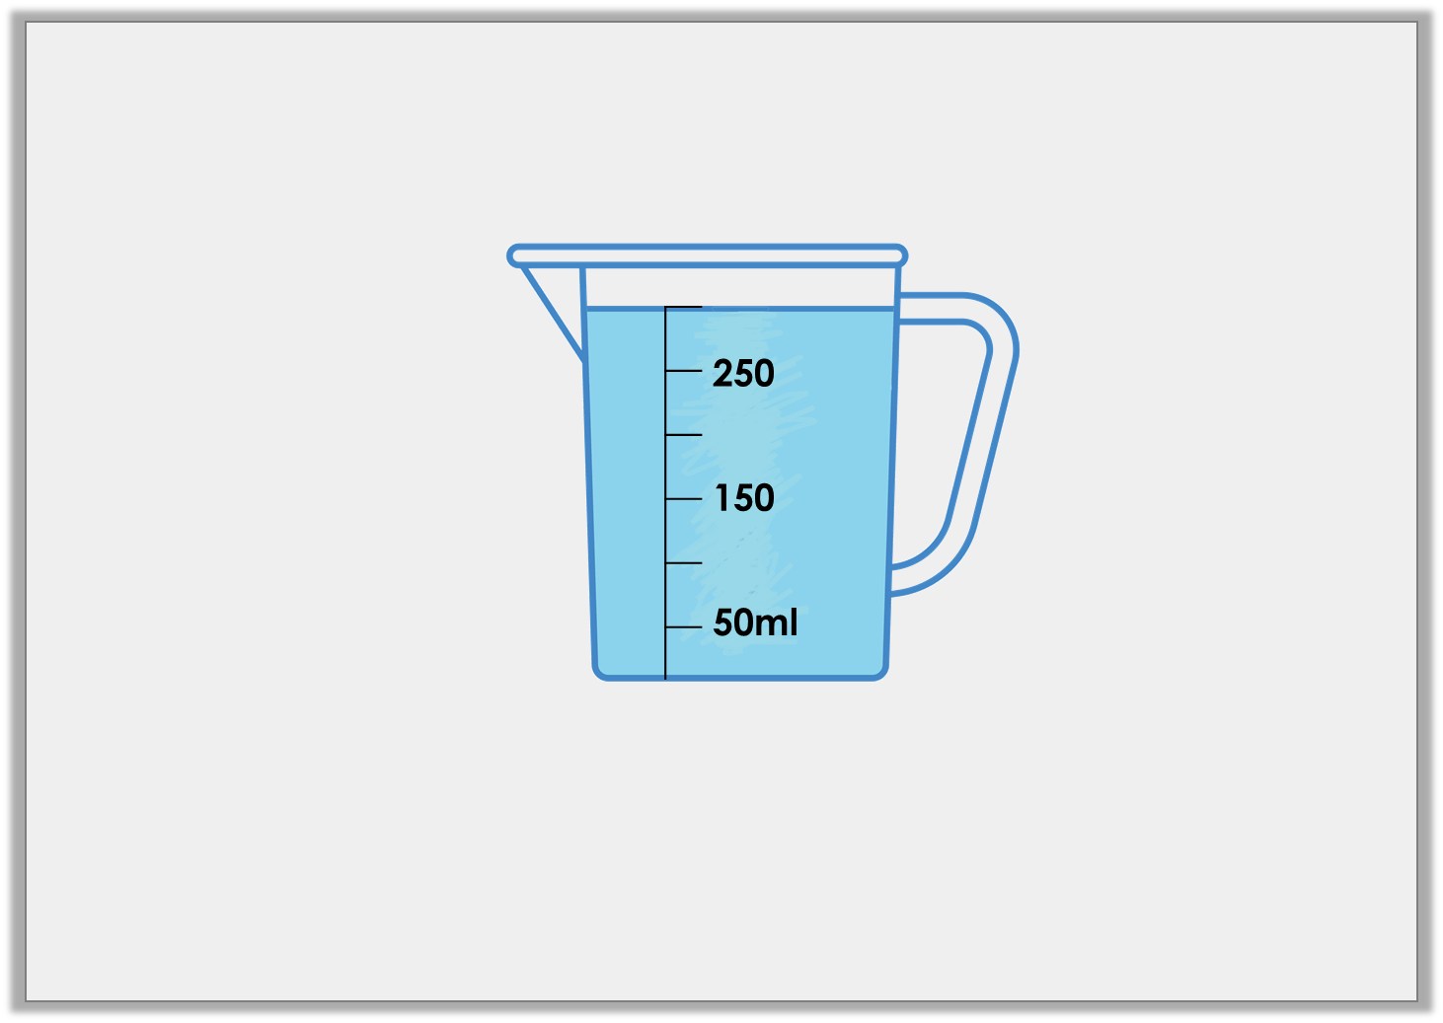
Question 1
True or false? There are 300ml of liquid in the jug below.
Y3
© Classroom Secrets Limited 2018

Slide 7
Answer 1
True or false? There are 300ml of liquid in the jug below.
True
Y3
© Classroom Secrets Limited 2018

Slide 8
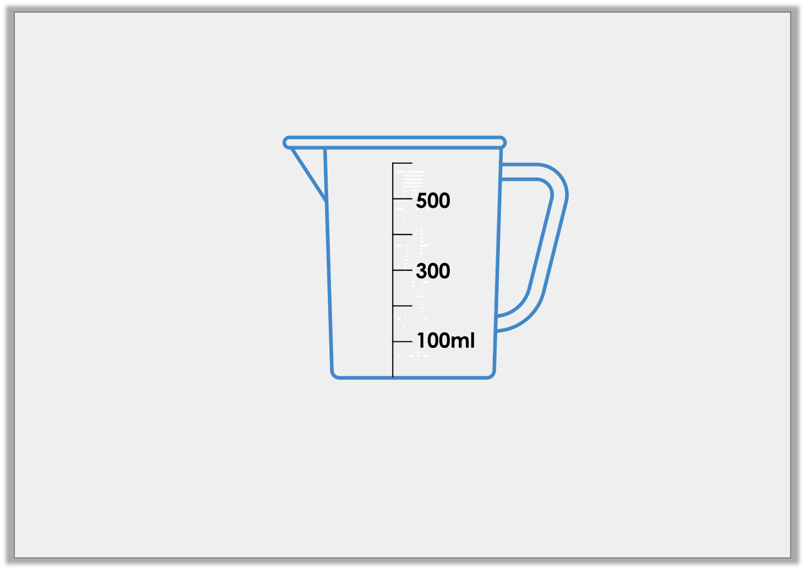
Question 2
Draw an arrow to show the water level for a volume of 200ml.
Y3
© Classroom Secrets Limited 2018

Slide 9
Answer 2
Draw an arrow to show the water level for a volume of 200ml.
Y3
© Classroom Secrets Limited 2018

Slide 10
Question 3
Match the volumes to the correct containers.
A
B
C
200ml
100ml
300
100ml
4L
2L
200ml
3LL
150ml
Y3
© Classroom Secrets Limited 2018

Slide 11
Answer 3
Match the volumes to the correct containers.
A
B
C
200ml
100ml
300
100ml
4L
2L
200ml
3LL
150ml
Y3
© Classroom Secrets Limited 2018

Slide 12
Question 4
Which is the odd one out? Explain your answer.
A
B
C
150ml
50ml
300
100ml
400ml
200ml
Y3
© Classroom Secrets Limited 2018

Slide 13
Answer 4
Which is the odd one out? Explain your answer.
B is the odd one out because the volume of liquid in both A and C is 200ml but the volume in C id 150ml.
A
B
C
150ml
50ml
300
100ml
400ml
200ml
Y3
© Classroom Secrets Limited 2018

Slide 14
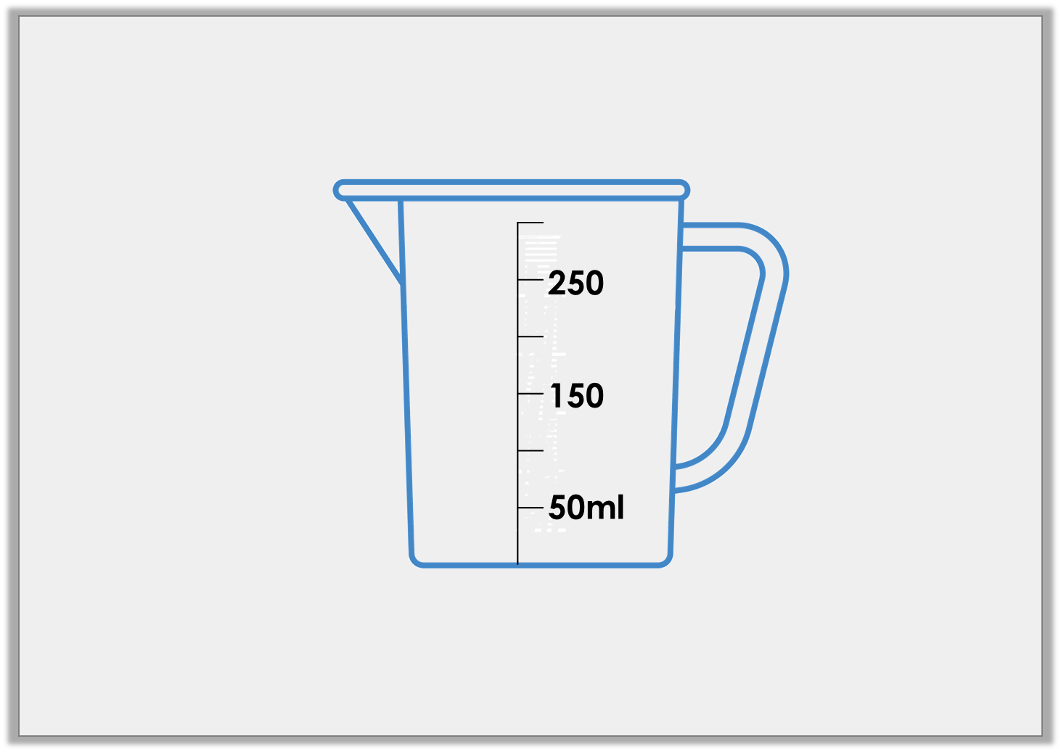
Question 5
Tom has poured water into the measuring jug below.
The volume is more 50ml than but less than 300ml.
How much water could he have?
Use arrows to label 3 possible answers.
Y3
© Classroom Secrets Limited 2018

Slide 15
Answer 5
Tom has poured water into the measuring jug below.
The volume is more 50ml than but less than 300ml.
How much water could he have?
Use arrows to label 3 possible answers.
250ml
200ml
100ml
Y3
© Classroom Secrets Limited 2018

Slide 16
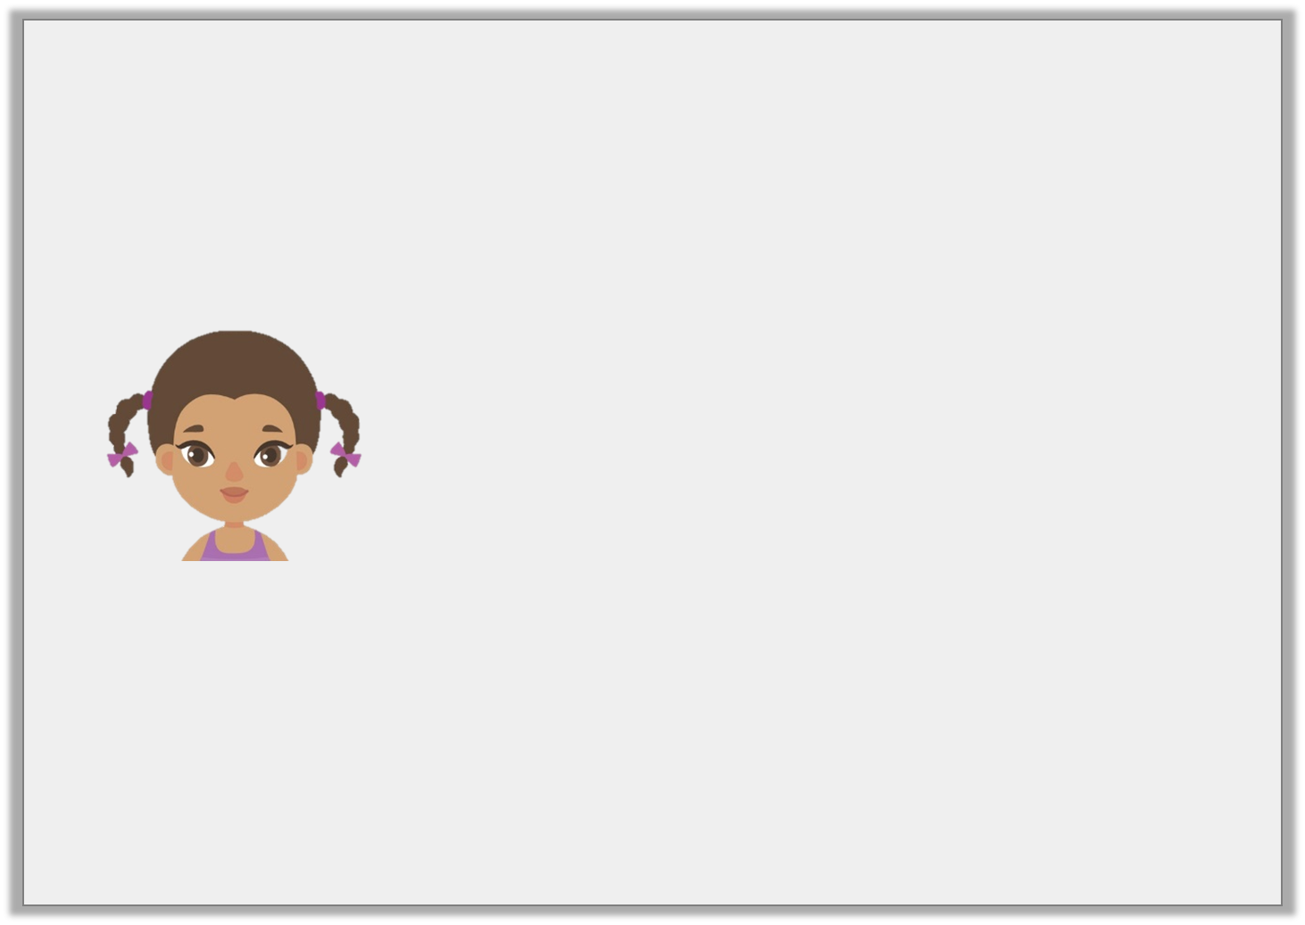
Question 6
Is Aisha correct? Explain your answer.
I have 200ml of liquid in my container.
250
150
50ml
Y3
© Classroom Secrets Limited 2018

Slide 17
Answer 6
Is Aisha correct? Explain your answer.
Alisha is correct because the scale is in increments of 50ml. The water level is between 150ml and 250ml so the volume of the liquid is 200ml.
I have 200ml of liquid in my container.
250
150
50ml
Y3
© Classroom Secrets Limited 2018

