Slide 1



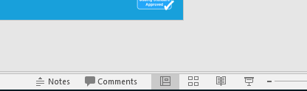


Guidance for Video/Audio in PowerPoints
1. Open the folder and copy all the files.
2. Paste the copied files into a new folder.
3. Open the PowerPoint file, enable editing and enter presentation mode (start the slide show). Go to slide 3 and the backing track will start automatically.
Please note the embedded audio may not be compatible with early versions of PowerPoint.
You may wish to delete this slide before beginning the presentation.

Slide 3


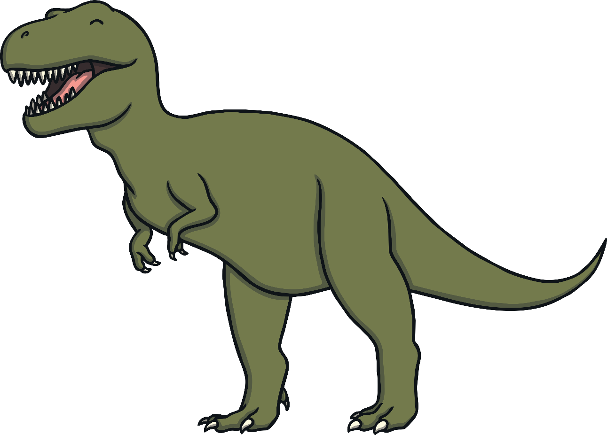
You’re a T. rex and you know it, show your claws.
You’re a T. rex and you know it, show your claws.
You’re a T. rex and you know it and you really want to show it,
You’re a T. rex and you know it, show your claws.

Slide 4
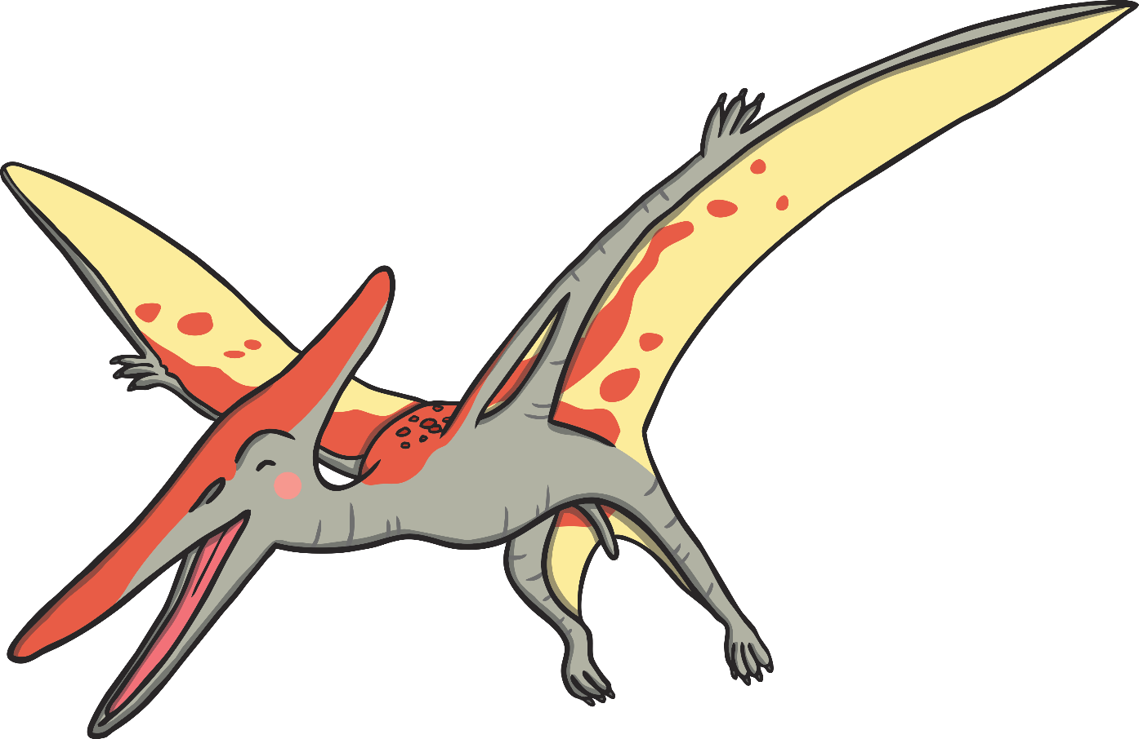
You’re a Pterodactyl flying, flap your wings.
You’re a Pterodactyl flying, flap your wings.
You’re a Pterodactyl flying, and you’re soaring and skydiving,
You’re a Pterodactyl flying, flap your wings.

Slide 5
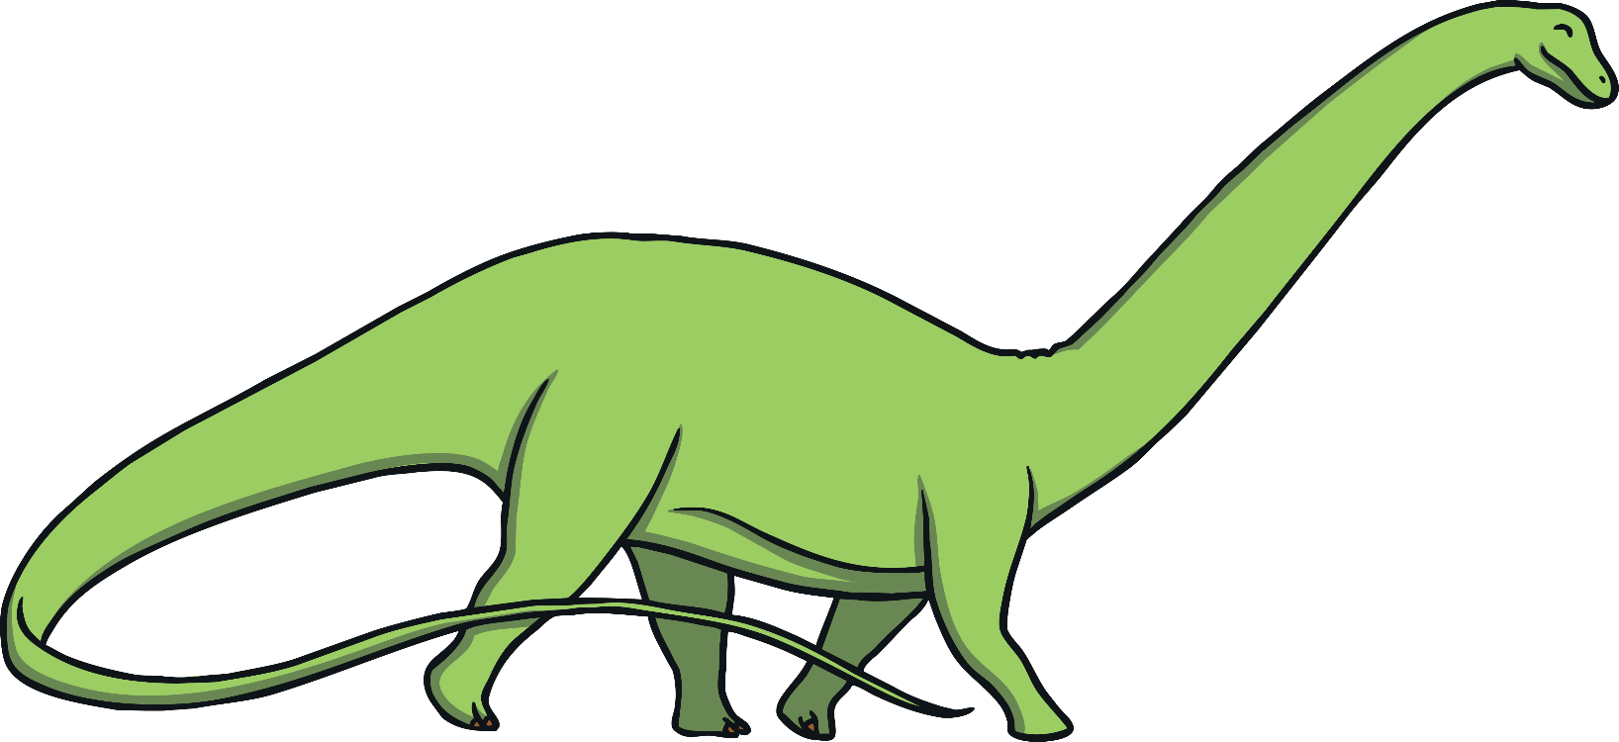
You’re a tall Apatosaurus, stretch your neck.
You’re a tall Apatosaurus, stretch your neck.
You’re a tall Apatosaurus, and you want to be the tallest,
You’re a tall Apatosaurus, stretch your neck.

Slide 6
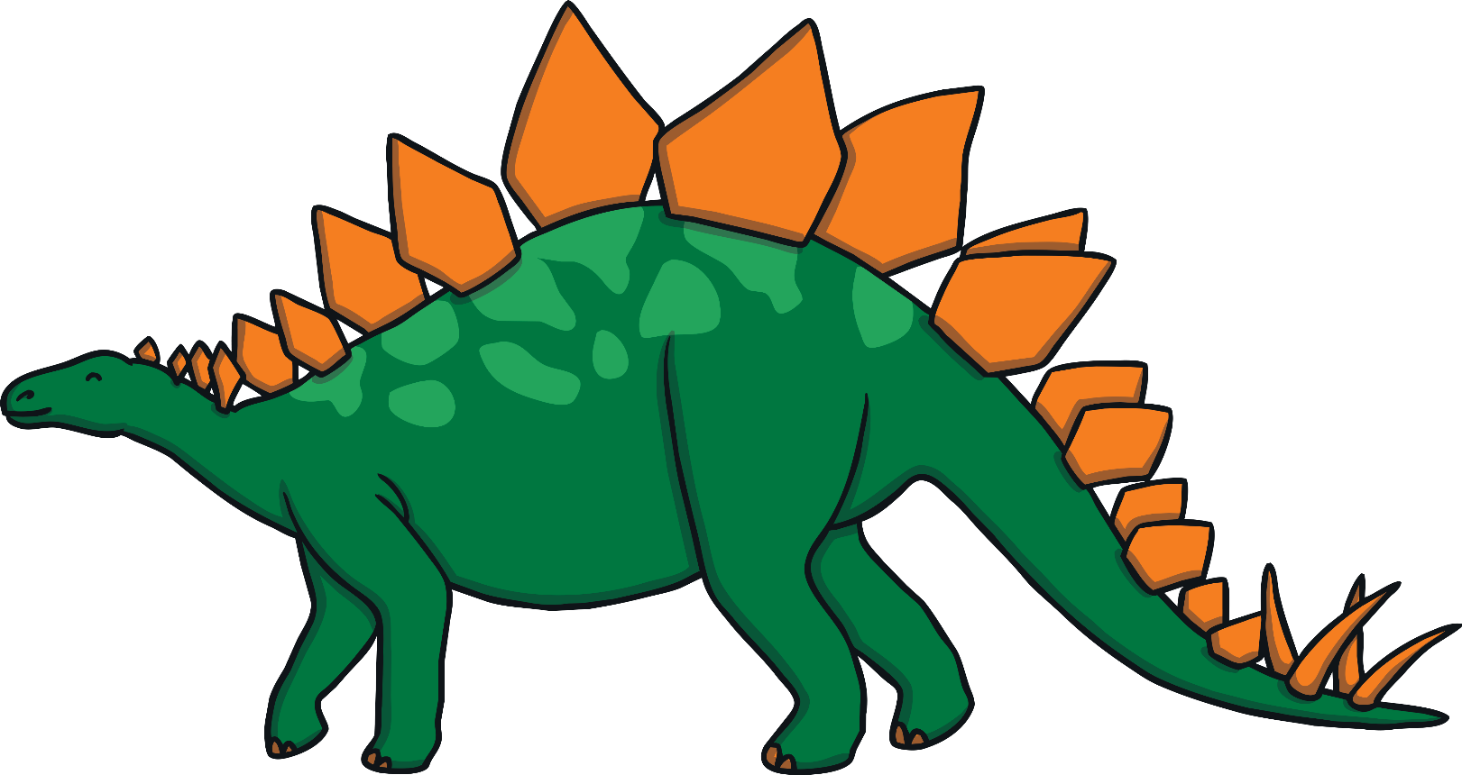
You’re a Stegosaurus fighting, crash your plates.
You’re a Stegosaurus fighting, crash your plates.
You’re a Stegosaurus fighting, and you want to be so frightening,
You’re a Stegosaurus fighting, crash your plates.

Slide 7
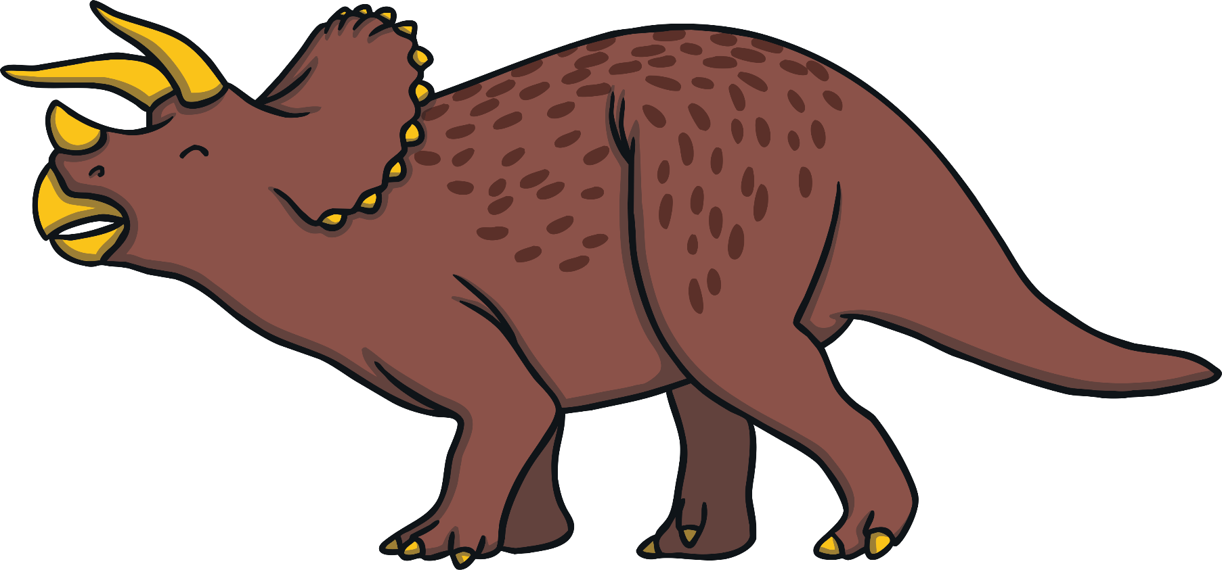
You’re a hungry Triceratops, raise your horns.
You’re a hungry Triceratops, raise your horns.
You’re a hungry Triceratops, and you’re grazing just never stops,
You’re a hungry Triceratops, raise your horns.

