Slide 1
QUIZ
1. Write down two prime numbers that add together to make 30.
2. Write down all the factors of 24.
3. Write down a multiple of 5 and 7 that is a 3 digit number.
4. Write down a square number between 60 and 99.
5. Write down a cube number that is also a multiple of 8.

Slide 2
QUIZ
6. How many vertices does a hexagonal pyramid have?
7. How many edges does an octahedron have?
8. Angle a in an isosceles triangle is 75º. Angle b is the same. What is angle c?
9. The area of a triangle is 12cm². The height is 6cm. What is the length of the base?
10. The area of a parallelogram is 48cm². What could the height and base be?

Slide 3
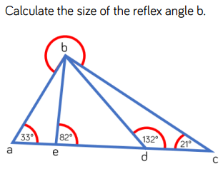
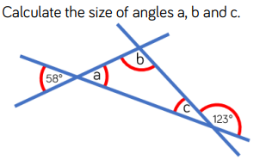
ULTIMATE CHALLENGE

Slide 4
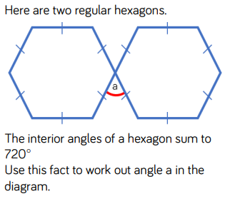
ULTIMATE CHALLENGE 2

