Slide 1
PEE
Point - “I think…”
Evidence – “The text says ….”
Explain – “This tells me ….”

Slide 2
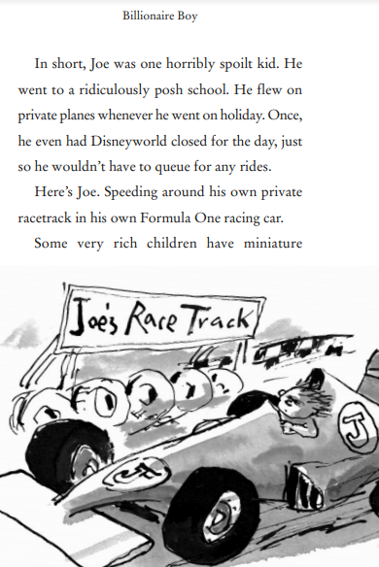
PEE
Joe is a nice normal
boy. Do you agree?
Use PEE to answer.
(3 marks)

Slide 3
PEE
I disagree, I don’t think Joe is a normal boy. The text says “Joe was horribly spoilt” and it says “he flew on
private planes”. This tells me
that he gets to do what he
wants and doesn’t live his life
like the majority of people.

