Slide 1
TASK
Retell the Viking legend – The Theft of Thor’s Hammer
Read the story (see pdf).
Use the picture story map to make notes about the key events.
Retell the story in your own words. Look at the success criteria and the WAGOLL first. Can you spot any features that are on the WILF? Try and include them in your writing. Feel free to magpie bits from the WAGOLL.

Slide 2
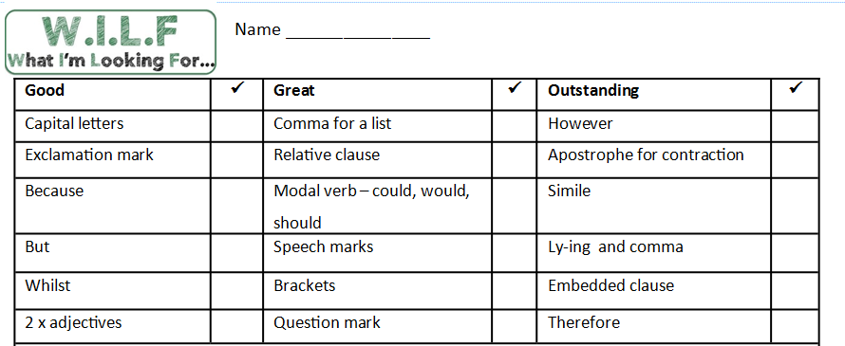

Slide 3
WAGOLL (first few paragraphs only!)
One morning, Thor woke from his deep slumber and couldn’t find his treasured hammer: Mjollnir. The hammer wielder, who was the potent god of thunder, immediately filled with anguish and fury.
In desperation, the frustrated god asked his close friend Loki for some help. Loki - the god of mischief - had an idea… He borrowed Freya’s impressive, falcon-feathered cloak and flew to Jotunheim to question Thrym about the missing hammer.
Moments later, the feathered god soared through the wind to the hall of the giants. As expected, Thrym – the frost giant – was waiting. Thrym confessed to stealing Thor’s prized hammer; he claimed to have buried it a staggering eight miles deep.

