Slide 1

Wednesday 11th November 2020
Poppy Art

Slide 2
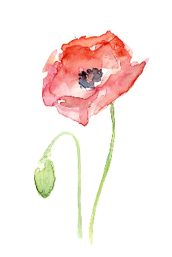
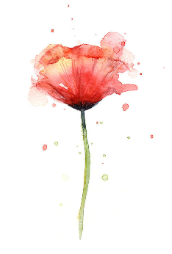
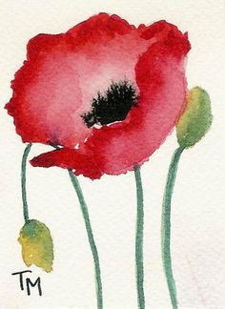
Have a look at the WAGOLLs below…
What do you like?

Slide 3
TASK
Look at the poppy images for inspiration. Or google for further ideas!
Sketch your poppy/or poppies on plain paper (cartridge is ideal).
Add colour to your design! Water colours would look great if you have them. *If so, practise mixing and creating different shades of colour first!*
SPLASH your design with black specks to symbolise shrapnel!

Slide 4
In Flanders Fields
By John Maccre
In Flanders fields the poppies blow
Between the crosses, row on row,
That mark our place; and in the sky
The larks, still bravely singing, fly
Scarce heard amid the guns below.
We are the Dead. Short days ago
We lived, felt dawn, saw sunset glow,
Loved and were loved, and now we lie,
In Flanders fields.
Take up our quarrel with the foe:
To you from failing hands we throw
The torch; be yours to hold it high.
If ye break faith with us who die
We shall not sleep, though poppies grow
In Flanders fields.
Extension Task
Copy this famous poem (in beautiful handwriting) onto your art work if you wish…
Or maybe… PRINT out the next slide and complete your poppy art over the text!

Slide 5
In Flanders Fields
By John Maccre
In Flanders fields the poppies blow
Between the crosses, row on row,
That mark our place; and in the sky
The larks, still bravely singing, fly
Scarce heard amid the guns below.
We are the Dead. Short days ago
We lived, felt dawn, saw sunset glow,
Loved and were loved, and now we lie,
In Flanders fields.
Take up our quarrel with the foe:
To you from failing hands we throw
The torch; be yours to hold it high.
If ye break faith with us who die
We shall not sleep, though poppies grow
In Flanders fields.

