Slide 1
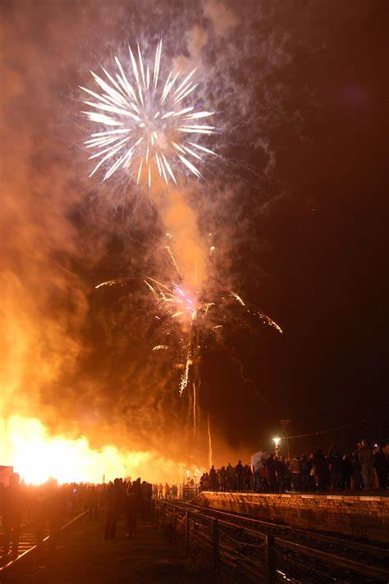
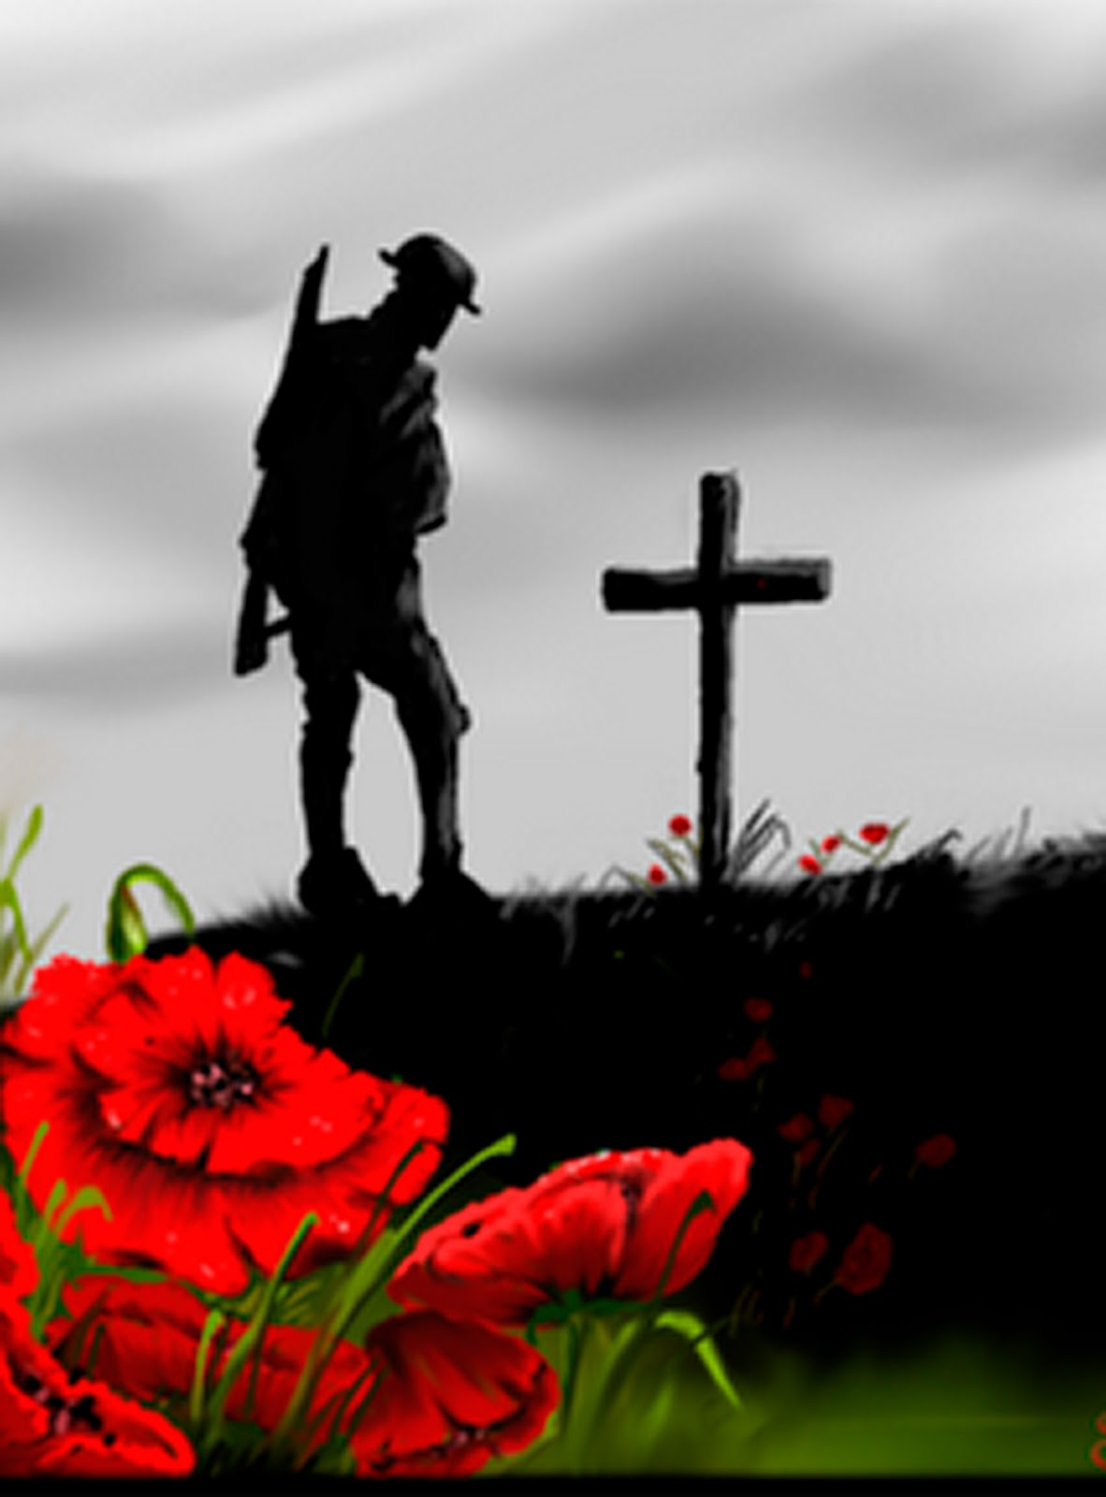
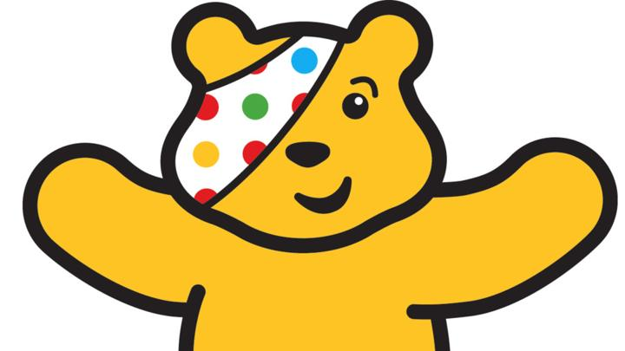
‘Our Wonderful World’ – Bonfire night, Remembrance Day and Children in Need.
Week beginning:
9th November 2020

Slide 2
The first five slides contain information for tasks linked directly to writing.
The last slide contains ideas for art activities that we will also be doing in school

Slide 3
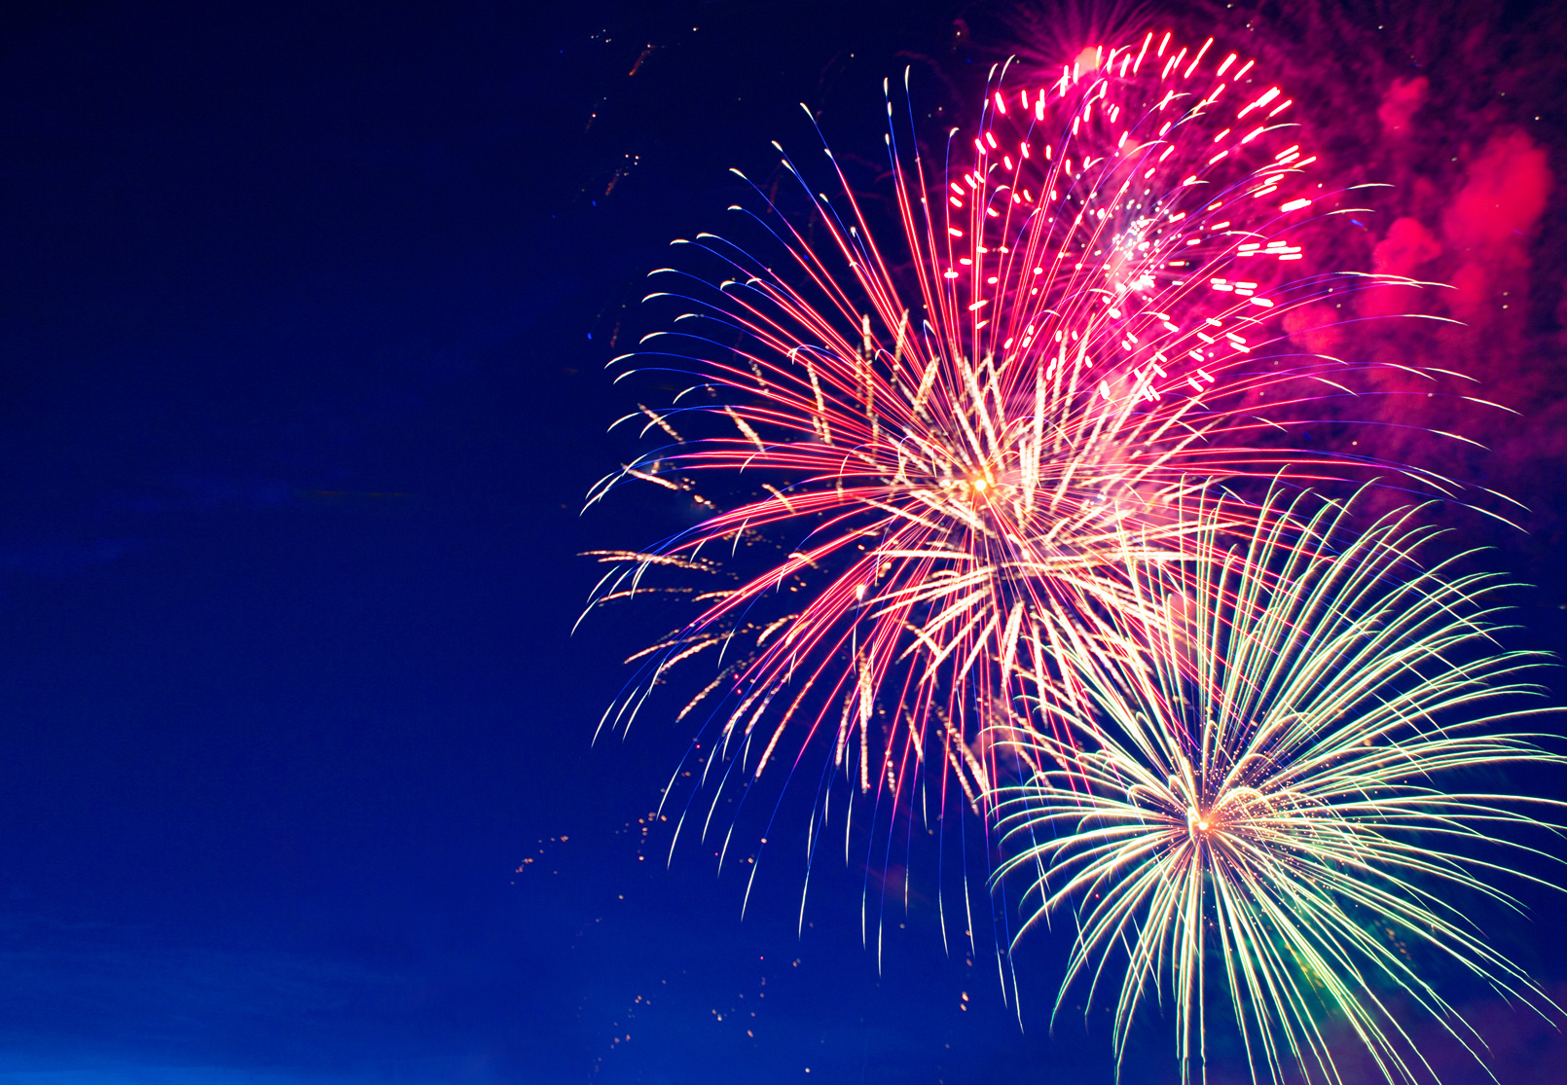
Monday 9th November
Last week at school we read the story ‘Sparks in the Sky’ (the story is an attachment on the website).
We would like you to gather vocabulary based around what you would be able to see, hear, smell/taste and feel on bonfire night.
Think about the foods that we tasted last week and read the story to help you think of ideas!

Slide 4
Tuesday 10th November
Using the vocabulary you gathered yesterday we would like you to write a senses poem.
Year 1: we have given you a word bank at the bottom of your sheet that you can choose from and use in your poem!
Remember to use:
Capital letters
Finger spaces
Full stops
Sound out words carefully
Year 2:
Use describing words (adjective) to make you senteces more exciting!

Slide 5
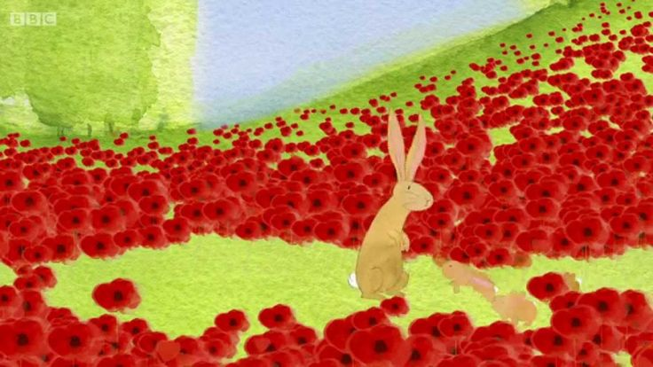
Wednesday 11th November
Remember to use:
Capital letters
Finger spaces
Full stops
Sound out words carefully
Year 2:
Use ‘and’ and ‘because’ to extend
your sentences
https://www.youtube.com/watch?v=wOT5CDnYHEs
As today is remembrance day we are remembering and thanking all the soldiers who fought for our country,
We would like you to watch a short video (click the link) and then using the pictures on the template we would like you to write the story of the video.

Slide 6
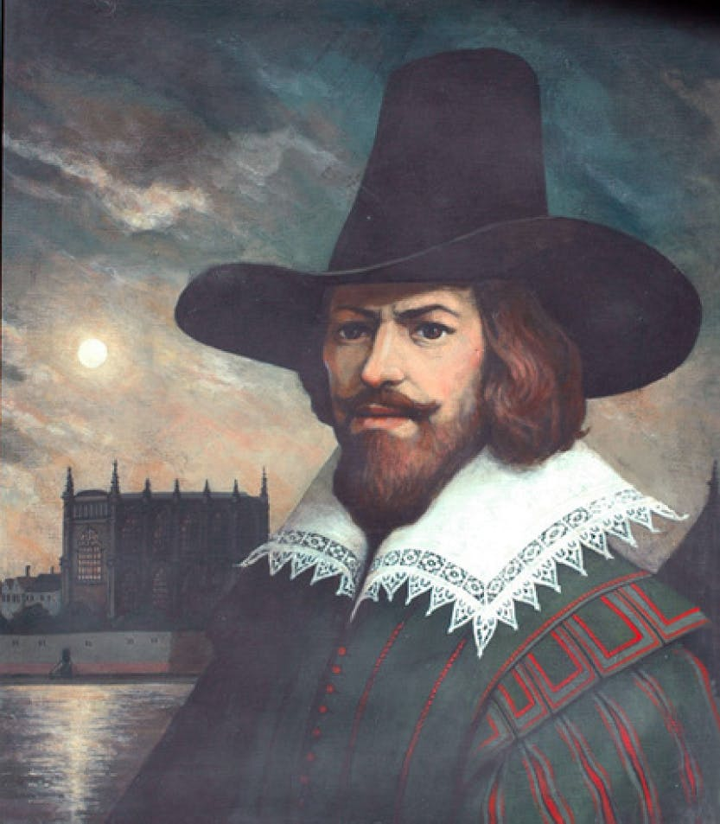
Thursday 12th November
Now that you’re familiar with ‘The Gunpowder Plot’ story, we would like you to make a wanted poster for Guy Fawkes!
Why would Guy Fawkes be a wanted person?
We would like you to draw Guy Fawkes and write a description of him e.g. what is he wearing? What colour is his hair?
Maybe even offer a reward for finding him!
Remember to use:
Capital letters
Finger spaces
Full stops
Sound out words carefully
Year 2:
Use describing words (adjectives) to enhance your descriptions!

Slide 7
Friday 13rd November
Today we are celebrating children in need day! To help raise awareness and money for the charity we will be having a pyjama day at school and invite you to do the same at home!
We have uploaded the story ‘Pudsey’s Great Fundraiser’ for you to read.
We would like you to design your own fundraiser. Draw a picture of what it is you would do and draw labels and write a description to explain how it would work!

Slide 8
Extra activities
Complete a line drawing of Guy Fawkes (pencil drawing)
Using the poppy template, could you create a collage poppy for Remembrance Day
Using a bottle top and some red paint could you make a field of poppies and use some black paint and your finger to complete the middle of the poppies of s black felt tip pen
Could you do one of Joe Wicks' ‘Wake up With Joe’ workouts at home?

Slide 9


