Slide 1

‘Our Wonderful World’
Week beginning:
19th October 2020
Take one picture

Slide 2
The first five slides contain information for tasks linked directly to writing.
The last slide contains ideas for art activities that we will also be doing in school.
Take one picture

Slide 3
Monday 19th October
Listen to the story of ‘Dogger’ by Shirley Hughes using this link:
https://www.youtube.com/watch?v=jNOYgRf5jes&feature=youtu.be
Now you have listened to the story again, have a think about what happens at the beginning, middle and end.
What we would like you to do is to draw a picture illustrating what happens at the beginning of the story and write some sentences to describe what happens.
Remember to use:
Capital letters
Finger spaces
Full stops
Sound out words carefully
Year 2:
Use ‘and’ and ‘because’ to extend
your sentences

Slide 4

Tuesday 20th October
Now that you have written the beginning of the story, remind yourself what happens next (you could always watch the story on YouTube again to remind yourself).
We would like you to think about the middle of the story where Dave loses Dogger.
Can you draw an illustration of when Dave loses Dogger and write some sentences describing this part of the story.
Remember to use:
Capital letters
Finger spaces
Full stops
Sound out words carefully
Year 2:
Use ‘and’ and ‘because’ to extend
your sentences

Slide 5
Wednesday 22nd October
You have now written a beginning and middle of the story so we need to finish it off with an ending!
At the end of the story Dave finds Dogger – can you remember how he found him?
We would like you to draw a picture of how Dave finds Dogger and write some sentences describing this part of the story.
Remember to use:
Capital letters
Finger spaces
Full stops
Sound out words carefully
Year 2:
Use ‘and’ and ‘because’ to extend
your sentences

Slide 6

Thursday 23rd October
Wow! You have written a beginning, middle and end of the story, we just need to finish it off with a front cover.
You can either try and recreate the front cover that is on the book or you could design your own using the characters in the story.
The front cover is below but there is a larger picture on the next slide.

Slide 8
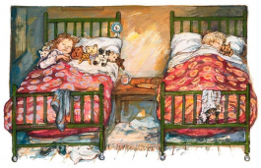
Friday 23rd October
Dave takes Dogger to bed and Bella sleeps with lots of teddies! Do you take any teddies to bed?
We would like you to draw us a picture of you in bed with you teddy/teddies and write labels.
Rremember to use capital letters, full stops and finger spaces!

Slide 9
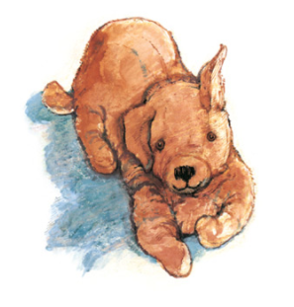
Extra activities
Draw a wanted poster to help and find Dogger (pencil drawing)
Draw pictures of ways that Dave could thank Bella for getting Dogger back. (Year 2s can label)
Draw a map to show the different events and activities that took place at the summer fair
Can you do any of the races that Bella did at the fair?

