Slide 2
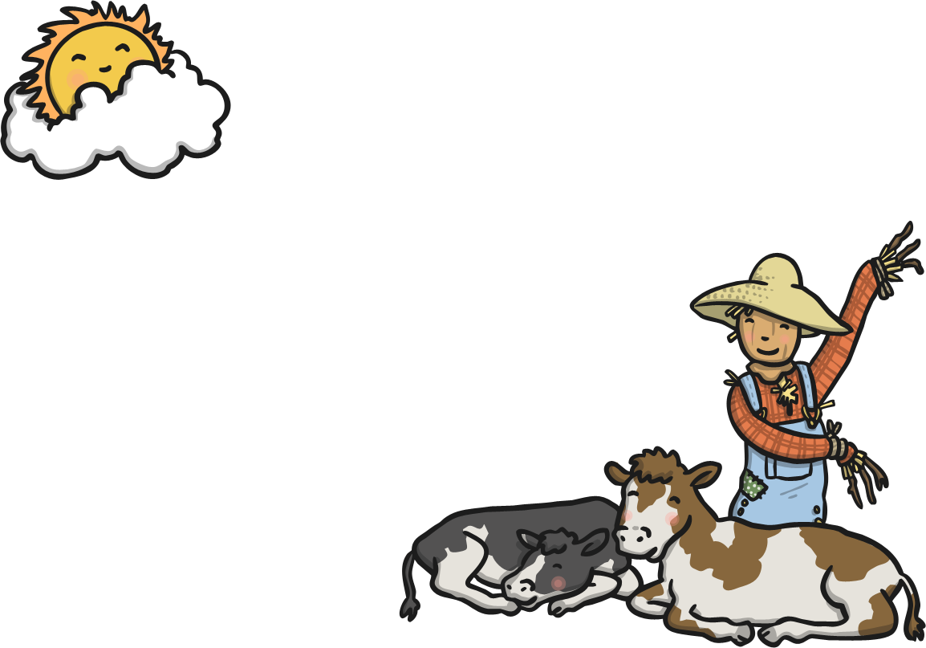
When all the cows were sleeping
^{and the sun had gone to bed,}
^{Up jumped the scarecrow}
^{and this is what he said…}

Slide 3
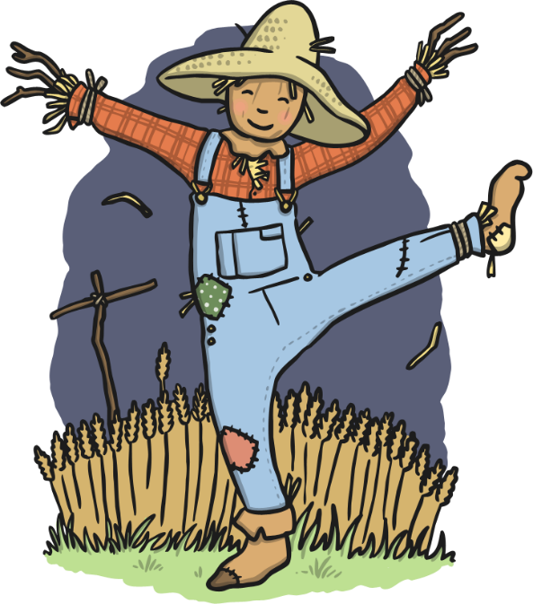
^{“I’m a dingle-dangle scarecrow}
^{with a flippy-floppy hat.}
I can shake my hands like this,
^{and shake my feet like that.”}

Slide 4
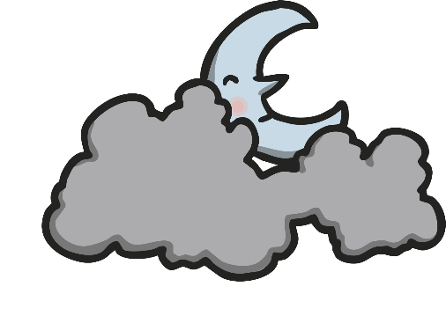

When all the hens were roosting
^{and the moon behind the cloud,}
^{Up jumped the scarecrow}
^{and shouted very loud…}

Slide 5
^{“I’m a dingle-dangle scarecrow}
^{with a flippy-floppy hat.}
I can shake my hands like this,
^{and shake my feet like that.”}

Slide 6
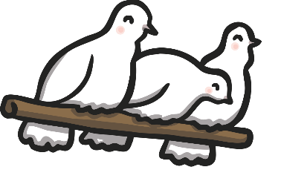

When the dogs were in the kennel
and the doves were in the loft,
^{Up jumped the scarecrow}
^{and whispered very soft…}

Slide 7
^{“I’m a dingle-dangle scarecrow}
^{with a flippy-floppy hat.}
I can shake my hands like this,
^{and shake my feet like that.”}

