Slide 1
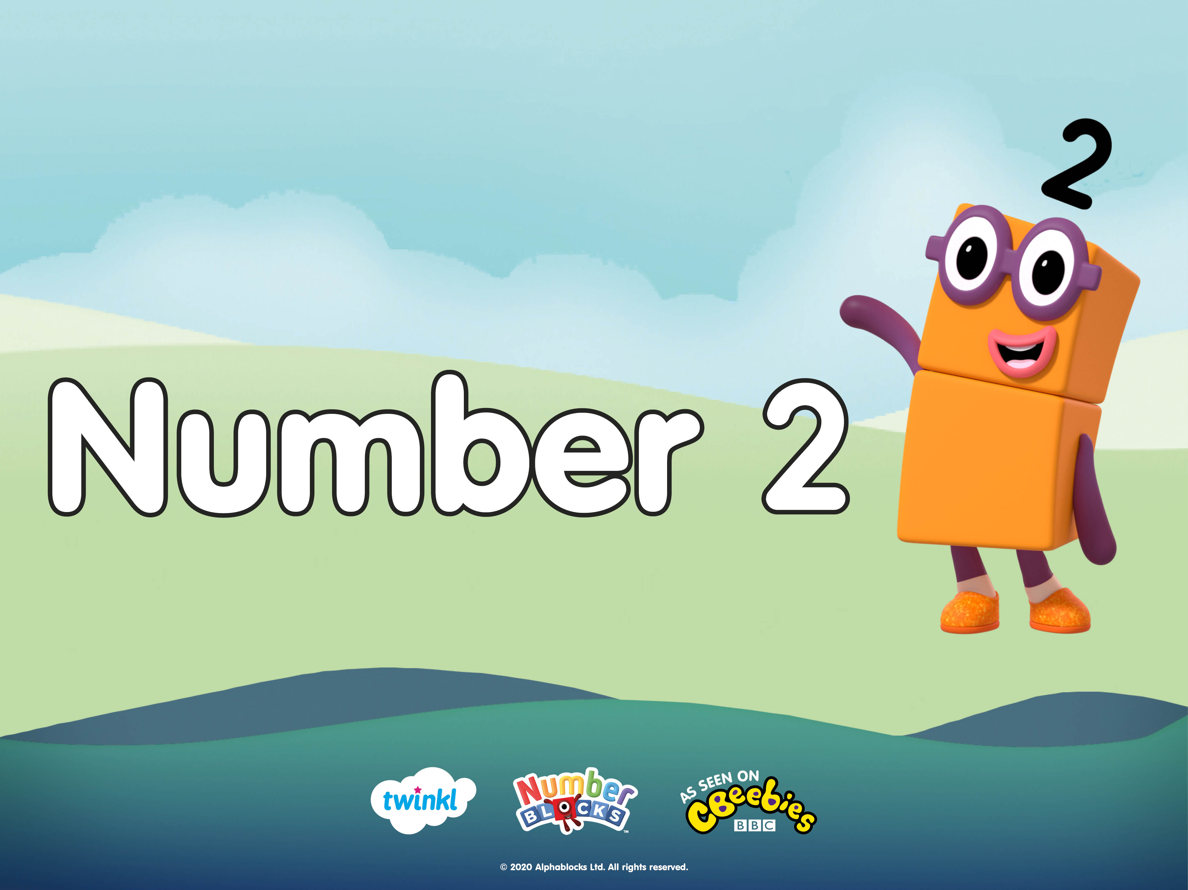

Slide 2





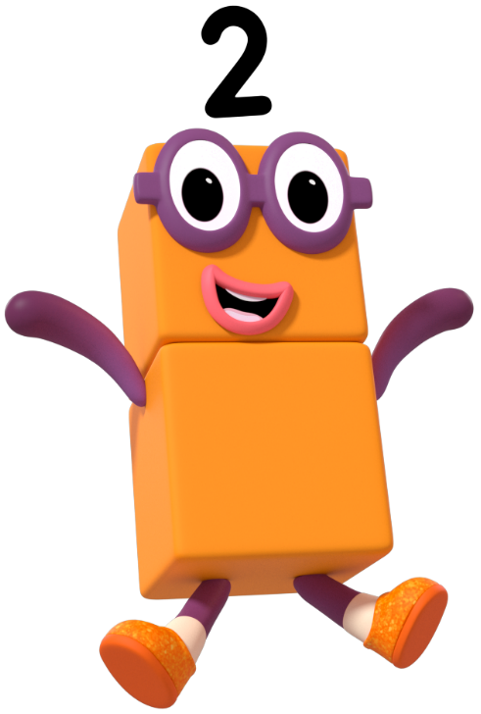
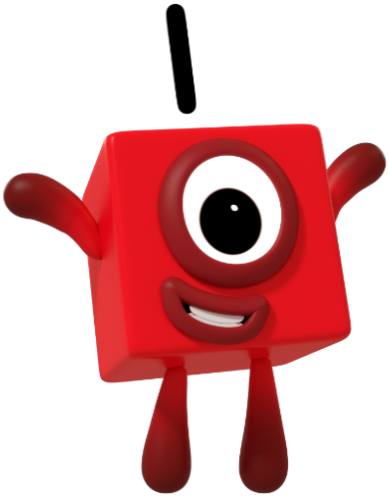
Oh no! The Numberblocks have muddled up their things and now they don’t know which items belong to them. Can you help the Numberblocks to sort the objects? Count the objects and click on the correct Numberblock to sort them.
I only have 1 of each object in my home.
I only have 2 of each object in my home.

Slide 3
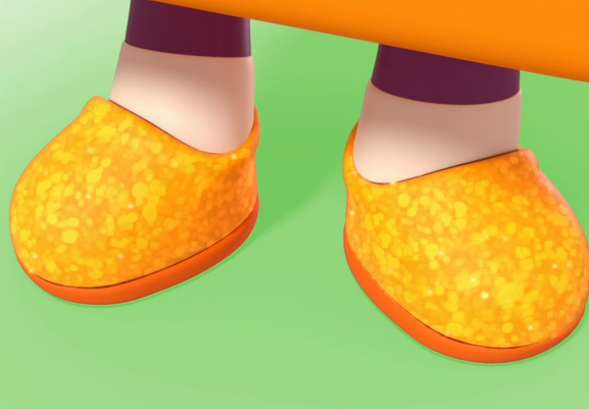



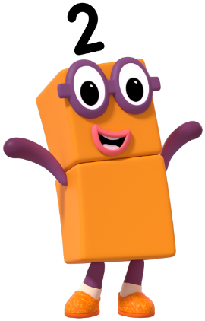
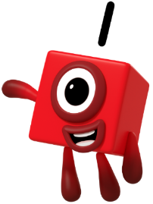
Try again.
How many shoes can you see?
I can see 2 shoes. Can you count them?
Click on the correct Numberblock.

Slide 4

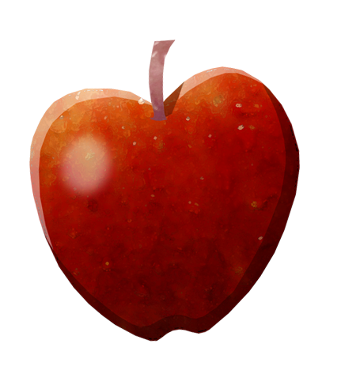
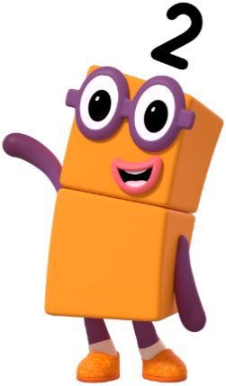
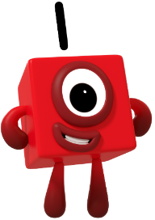
There is 1 apple. How did you work it out?
Try again.
How many apples can you see?
Click on the correct Numberblock.

Slide 5
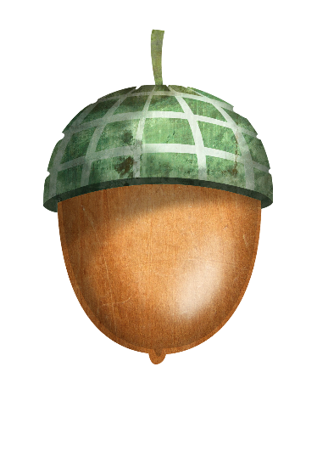
I can see 2 acorns. Can you show me 2 on your fingers?
Try again.
How many acorns can you see?
Click on the correct Numberblock.

Slide 6
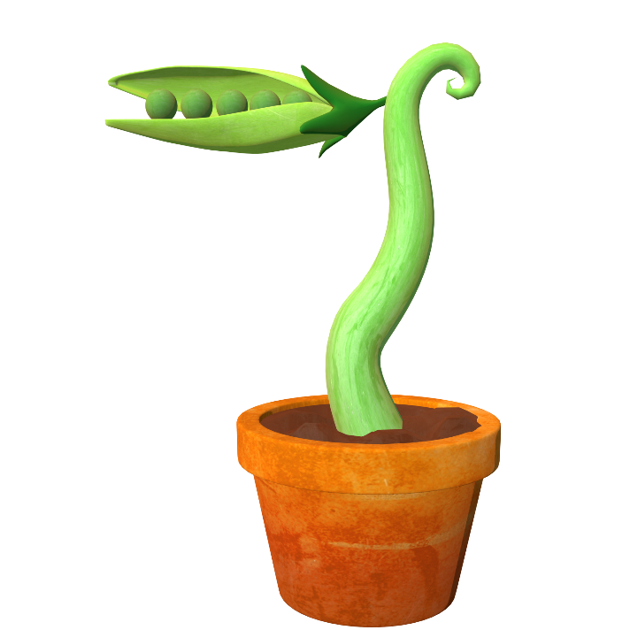
How many plants can you see?
I think I can see 1 plant. Am I right? How do you know?
Try again
Click on the correct Numberblock.

Slide 7
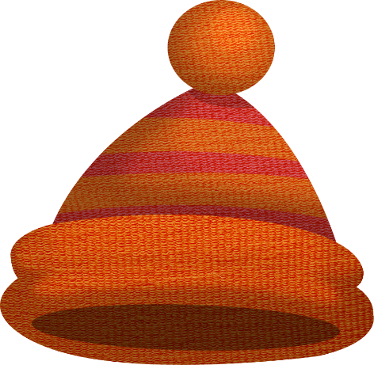
How many hats can you see?
I think I can see 2 hats. Am I right? How can I check?
Try again.
Click on the correct Numberblock.

Slide 8
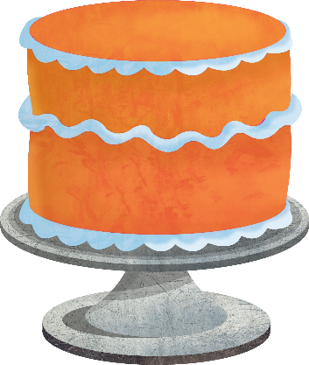
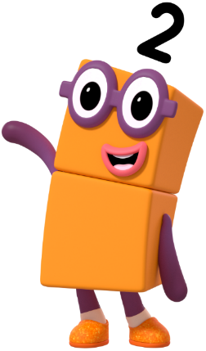
How many cakes can you see?
That’s right - there are 2 cakes. Can you tell a friend how you knew that?
Try again.
Click on the correct Numberblock.

Slide 9
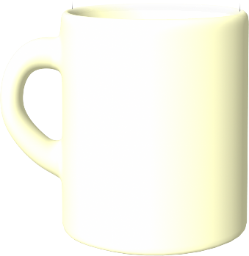
How many cups can you see?
Try again.
I can see 2 cups. Can you count them?
Click on the correct Numberblock.

Slide 10

Can you tell me in a sentence what you can see? I can see…
Try again.
How many balloons can you see?
Click on the correct Numberblock.

Slide 11
Try again.
Can you count the cakes to see if you are right? How many cakes did you count?
How many cakes can you see?
Click on the correct Numberblock.

Slide 12

I think I can see 2 plants. Am I right? Can you tell a friend?
How many plants can you see?
Try again.
Click on the correct Numberblock.

Slide 13
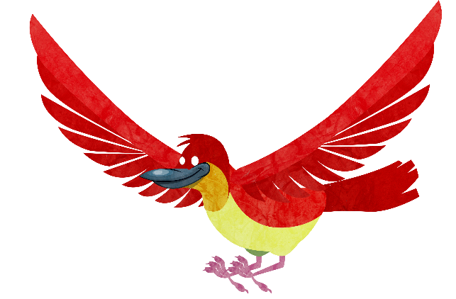
How many birds can you see?
I can see 1 bird. Can you show me 1 on your fingers?
Try again.
Click on the correct Numberblock.

Slide 14
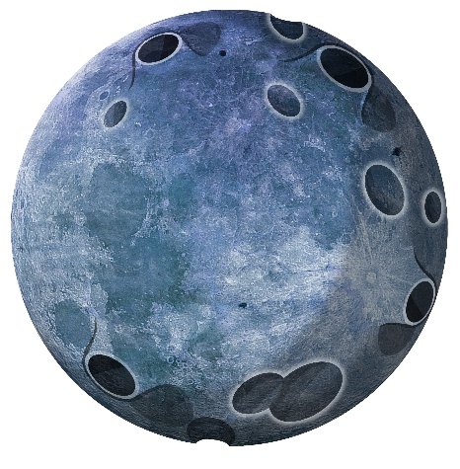
Try again.
I can see 2 moons. Can you tell me how you know there are 2?
How many moons can you see?
Click on the correct Numberblock.

Slide 15


How many birds can you see?
There are 2 birds in the sky. Do you agree?
Try again.
Click on the correct Numberblock.

Slide 16







Click the object to match it to the correct Numberblock.

Slide 17





Can you tell me all the ways that you can see two? Say, “I can see 2…”

Slide 18




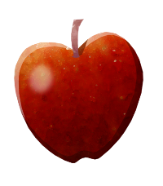


Can you tell me all the ways that you can see one?
Say, “I can see 1…”

Slide 19


