Slide 1
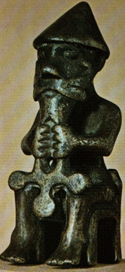
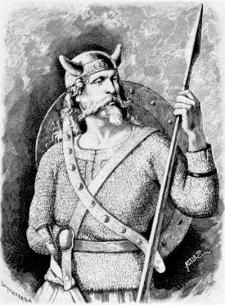
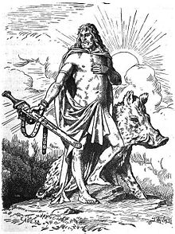
Anglo-Saxon Beliefs
God of battle
- Tiw
God of rain and crops
- Frey
God of Thunder
- Thor
WALT: understand the Saxon religion.

Slide 2
Pagan Religion
The Anglo-Saxons were pagans, who did not believe in the Christian God. Gradually the Christians outside Britain returned to England and Scotland and began to covert the Picts, Scots and the Anglo-Saxons and after a while most of England became Christians.
Each pagan god controlled a particular part of everyday life: the home, growing crops, healing, wisdom, metalworking, love, the weather, the family, war and day and night.

Slide 3
Pagan Beliefs..did you know…
Our word Easter comes from the name of the Anglo-Saxon goddess of the dawn, Eostre.
When the Saxons first settled in Britain, they were pagans. This means that they worshiped lots of different gods. Their religion was called 'paganism'.
The Saxons were very superstitious and believed in elves, goblins and dragons.

Slide 4
The Anglo-Saxons worshipped the gods Tiw, Woden, Thor and Frig. From these words come the names of our days of the week: Tuesday, Wednesday, Thursday, Friday. Most of the days of the week are named after Saxon gods. Can you work out which ones?
Tiw’ day
Woden’s day
Thunor’s day
Frig’s day

Slide 5
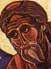
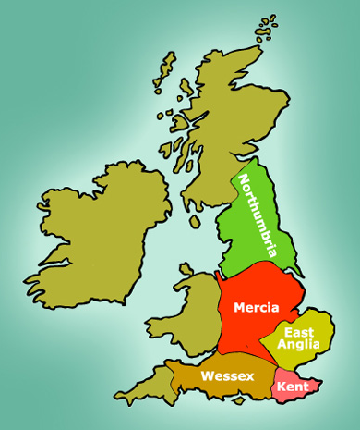
How did the Anglo-Saxons become Christians?
The Anglo-Saxons became Christians because some kind and clever priests came to teach them all about God, Jesus and the Church. Many of these kind and clever priests became saints.
St Augustine was sent from Rome to teach the Anglo-Saxons in the south of Britain. He became the first Archbishop of Canterbury.
St Aidan came from Ireland. He went to live on the island of Lindisfarne, which is off the north-east coast of England. He taught the Anglo-Saxons in the north of England.
St Cuthbert was an Anglo-Saxon who was one of Aidan’s first pupils. He became a Christian teacher himself.

Slide 6
What Christian buildings did they erect?
Once the Anglo-Saxons became Christians, they built many churches. Some churches were big and were called ‘minsters,’ some were little, and they were all around the country.
This map shows the different Anglo-Saxon kingdoms. Why do you think the first churches were built in Northumbria and Kent?
The Anglo-Saxons also built monasteries and abbeys. Some famous Anglo-Saxon abbeys were at Whitby, Winchester, Ely near Cambridge and Wearmouth-Jarrow, near Newcastle.

Slide 7
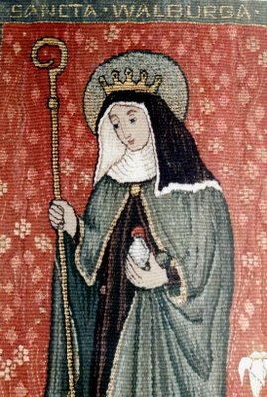
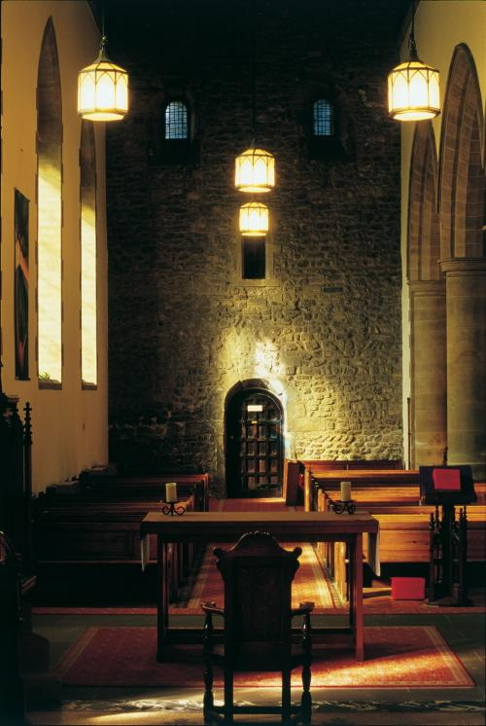
Who lived in these buildings?
Monks and nuns lived in the monasteries and abbeys. These were Christian men and women who decided to live together in a community, instead of staying with their families or marrying and having children of their own. The women would live with other women, and the men would live with other men.
The monks and nuns spent their lives in prayer, at work looking after their home and growing food, or doing good work for the families who lived around them. They taught children, ran hospitals, said Mass, and because they were the only people who were literate, they would do any reading or writing that anybody needed. They also made art.

Slide 8
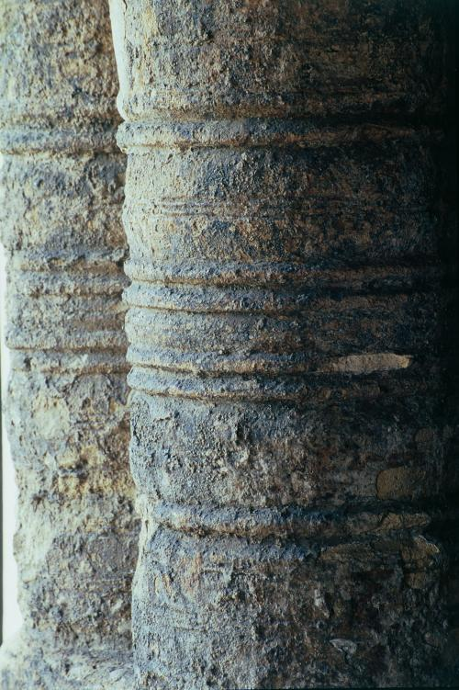
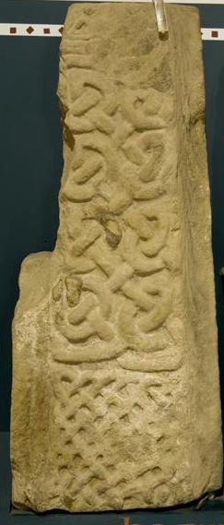
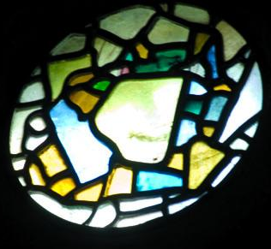
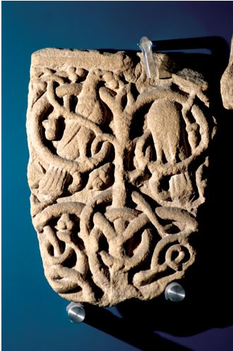
What amazing art did they make?
The Anglo-Saxon monks and nuns made art in stone, glass and parchment. Much of this artwork has been lost, but we can still see some of it today.
This stained glass window is made of real Anglo-Saxon glass. It is from the famous monastery of Wearmouth-Jarrow.
Wearmouth-Jarrow had some of the first stone buildings in England. The stone was carved into animal and plant shapes and painted bright colours.

