Slide 1




Year 6 - Autumn - Block 1
Place Value

Slide 2
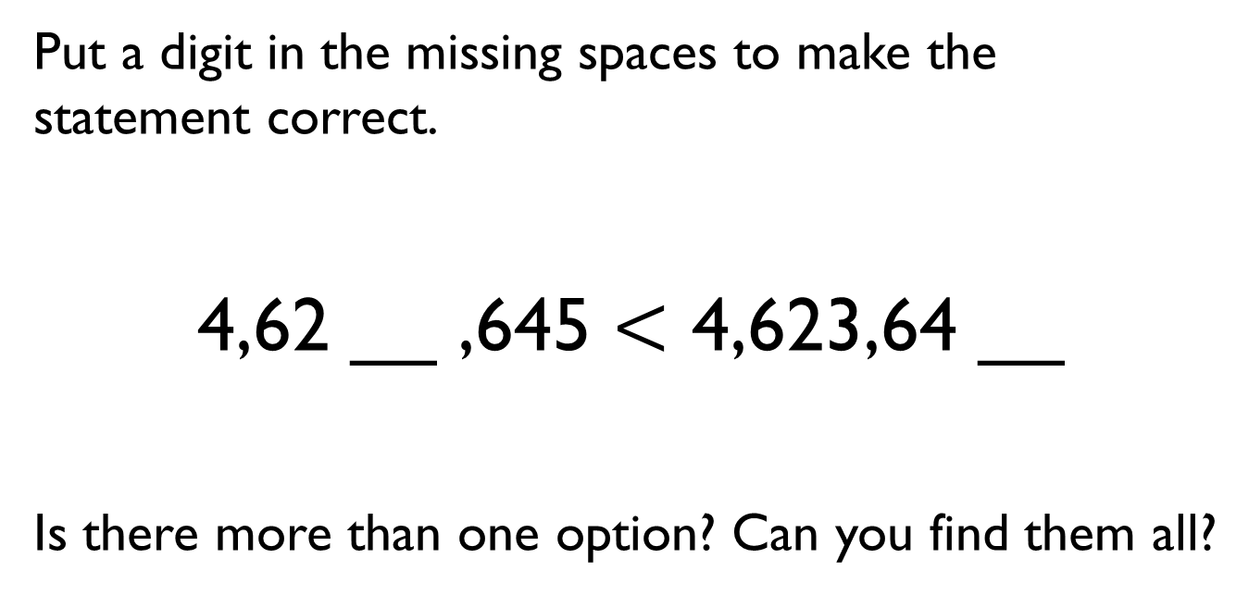
Put a digit in the missing spaces to make the statement correct.
4,62 __ ,645 $<$ 4,623,64 __
Is there more than one option? Can you find them all?
M | HTh | TTh | Th | H | T | O

Slide 3
Dora has the number 824,650
She subtracts forty thousand from her number.
She thinks her new number is 820,650
Is she correct?
Explain how you know.

Slide 4
Use the digit cards and statements to work out my number.
The ten thousands and hundreds have the same digit.
The hundred thousand digit is double the tens digit.
It is a six-digit number.
It is less than six hundred and fifty-five thousand.
Is this the only possible solution?
0
3
3
5
5
6
7

Slide 5
Jack draws bar model A.
His teacher asks him to draw another where the total is 30,000
A
B
Explain how you know bar B is inaccurate.
50,000
10,000
30,000

Slide 6
Whitney rounded 2,215,678 to the nearest million and wrote 2,215,000
Can you explain to Whitney what mistake she has made?

Slide 7
15,987 15,813 15,101 16,101
Tommy says, “My number rounds to 16,000 to the nearest 1,000”
Alex says, “My number has one hundred.”
Jack says, “ My number is 15,990 when rounded to the nearest 10”
Dora says, “My number is 15,000 when rounded to the nearest 1,000”
Can you work out which child has which card?

Slide 8

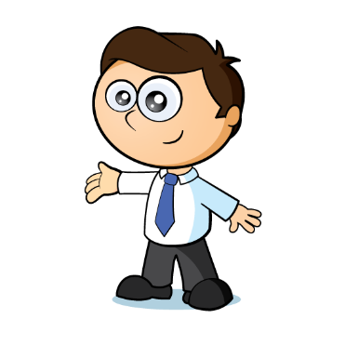
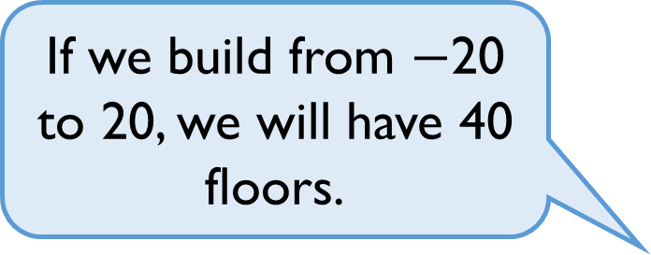
A company decided to build offices over ground and underground.
Do you agree? Explain why.
If we build from $−$20 to 20, we will have 40 floors.

