Slide 1

‘Our Wonderful World’
Week beginning:
12th October 2020
Take one picture

Slide 2
The first five slides contain information for tasks linked directly to writing.
The last slide contains ideas for art activities that we will also be doing in school.
Take one picture

Slide 3
Monday 12th October
Listen to the story of ‘Dogger’ by Shirley Hughes using this link:
https://www.youtube.com/watch?v=jNOYgRf5jes&feature=youtu.be
We would like you to order the events from the story (please see resources tabs). There are 6 pictures altogether. Please place them in order from beginning to end
When you have done this, can you write a sentence for each picture to explain what is happening.
Remember to use:
Capital letters
Finger spaces
Full stops
Sound out words carefully
Year 2:
Use ‘and’ and ‘because’ to extend
your sentences

Slide 4

Tuesday 13th October
Look at the picture of Dave.
Can you think of adjectives to describe his appearance?
(Remember: an adjective is a describing word)
Year 2: Can you also think about how Dave is feeling.
Today we only need key words as tomorrow you will turn them into full sentences.

Slide 5
Wednesday 14th October
Using the vocabulary that you
collected yesterday, can you now
turn it into full sentences?
Remember to use:
Capital letters
Finger spaces
Full stops
Sound out words carefully
Year 2:
Use ‘and’ and ‘because’ to extend
your sentences

Slide 6
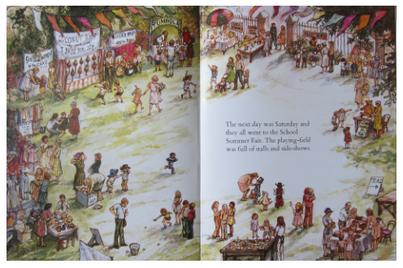
Thursday 15th October
Look at the picture of setting: the school.
Can you write a list of the different activities and stalls that you can see?
Year 2: Can you also include adjectives (Remember: an adjective is a describing word)
There is a larger version of this picture on the next slide, if needed.

Slide 8
Friday 16th October
Using the vocabulary that you
collected yesterday, can you now
turn it into full sentences?
Remember to use:
Capital letters
Finger spaces
Full stops
Sound out words carefully
Year 2:
Use ‘and’ and ‘because’ to extend
your sentences

Slide 9
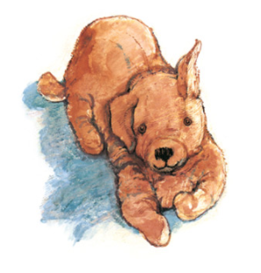
Extra activities
Draw Dogger (pencil drawing only)
Draw Dave (add colour)
Design your own fancy dress costume
Think about your toys: what is your favourite toy and why? (Draw and label)

