Slide 1

The
Journey
of Life
©Flickr/rubyblossom

Slide 2

©Flickr/wieland 7

Slide 3

©Flickr/webmink

Slide 4

©Flickr/Dey

Slide 5

©Flickr/Al Jazeera English

Slide 6

©Flickr/Matthew Wilkinson

Slide 7

©Flickr/Gashwin

Slide 8

©Flickr/midlander1231

Slide 9

Top Ten Tips for the Trip of Your Lifetime
©Flickr/Andy Hares

Slide 10

1. Keep the tower in sight
©Flickr/tpholland

Slide 11
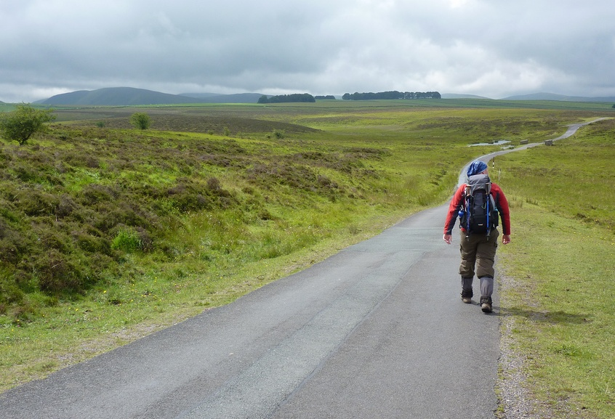
2. Start walking
©Flickr/Bods

Slide 12

3. Get equipped
©Flickr/M.Hillier

Slide 13
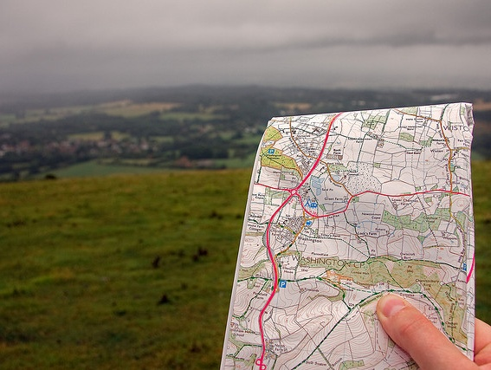
4. Get directions
©Flickr/Simon Grieg (xrrr)

Slide 14
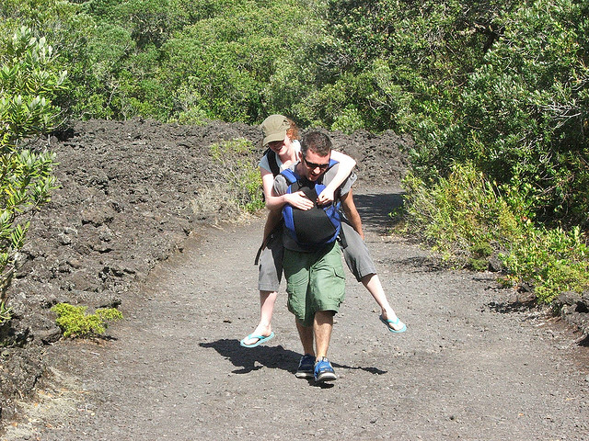
5. Get help
©Flickr/Dunk the Funk

Slide 15

6. Read the signs
©Flickr/Doha Sam

Slide 16

7. Get lost
©Flickr/sonson

Slide 17

8. Be kind to the people you meet
©Flickr/Juan Mann

Slide 18

9. Explore!
©Flickr/ockenden

Slide 19

10. Enjoy the journey!
©Flickr/Joseph Knapp Photography

Slide 20
A journey of a thousand miles starts with a single step
©Flickr/midlander1231

