Slide 1
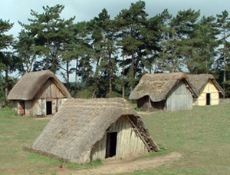
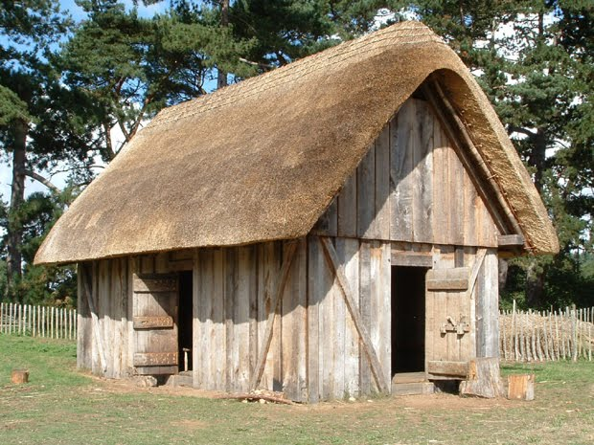
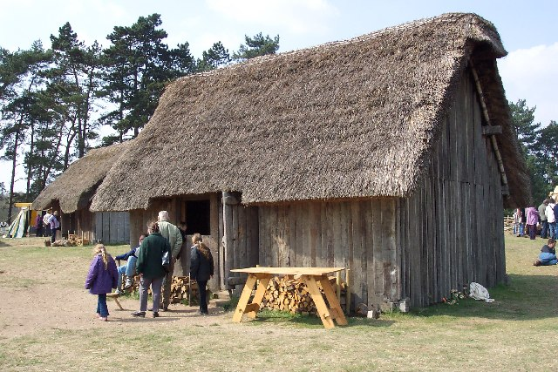
Village life
WALT: understand where and how the Anglo-Saxons lived.

Slide 2
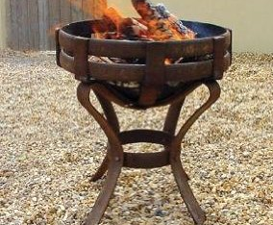
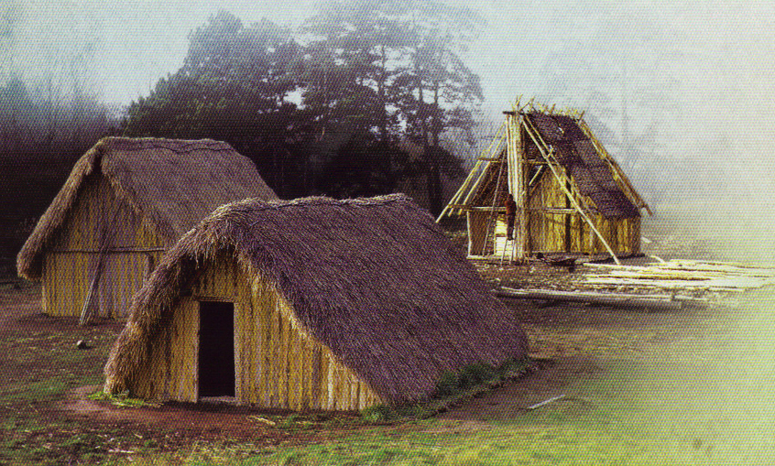
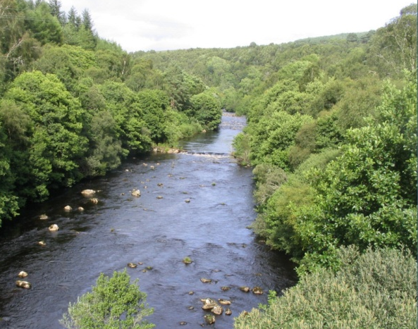
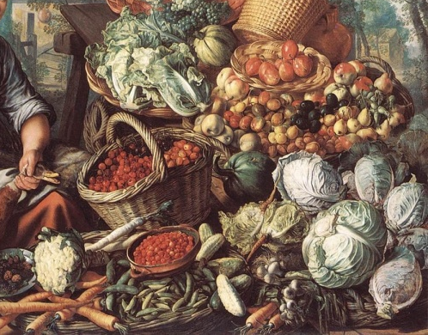
Everyday life…
Most of the Anglo-Saxon settlers lived as farmers. The villages were built near natural resources. The villagers needed food, water, fuel for heating and cooking and materials for their homes and clothes. The natural resources had to provide the villagers with what they needed to survive.

Slide 3
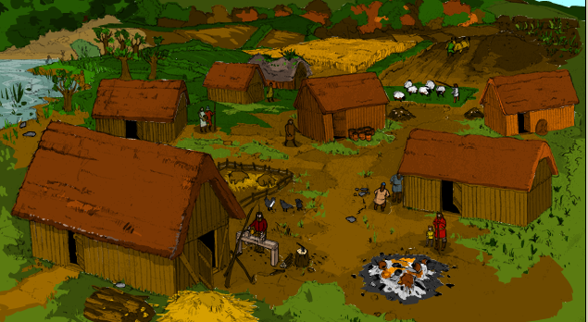
Virtual Village
Click on the link below to view a typical Anglo-Saxon Village.
Virtual Village

Slide 4
Some interesting facts..
The Anglo-Saxons grew crops and kept: pigs, sheep and cattle.
They hunted other animals and fish for food. They made household goods and farm equipment from pottery, wood and metal; clothes from cloth they wove themselves.
They traded goods such as: hunting dogs and slaves for things they couldn't make; like glass, with people from other countries.
The houses were built facing the sun to get as much heat and light as possible.
There was only one room where everybody ate, cooked, slept and entertained their friends.

