Slide 1
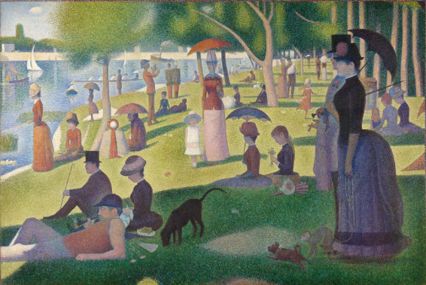
Week 3 – 21.09.20

Slide 2
Gathering vocabulary
Take a close look at the picture.
What can you see?
Write a list of the items that you can see.
Year 2: remember to
include adjectives,
e.g. green tree.

Slide 3
Gathering vocabulary
Take a close look at the picture.
Imagine you are in the picture.
What can you hear?
Write a list of the
items that you can
hear.
Year 2: remember to
include adjectives,
e.g. rustling leaves.

Slide 4
Time to write!
Using the vocabulary that you have gathered, we would now like you to turn your words into sentences.
Remember: capital letters, finger spaces, full stops, sound out words carefully.
Year 1: We would like 4 sentences altogether.
Year 2: We would like at least 8 sentences. Remember to use adjectives and join your sentences using ‘and’.

Slide 5
Time to draw!
Now take another look at the painting by George Seurat.
We would like you to have a go at drawing the painting yourself, using only your pencil.
You can either draw a small section of the painting or draw the whole painting.
We can’t wait to see your art work.

Slide 6
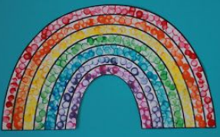
Time to paint
George Seurat is famous for pointillism: where you fill space with a series of dots.
We would like you create a rainbow using pointillism.
You can use the template attached or go free-hand!
You can use felt tip pens or paints.
We can’t wait to see your pointillism rainbows.

